Slide 1
Second presentation
Marcel Siwiela

Slide 2
The objective of the project
Reading data from several sensors:
Temperature and humidity – DHT11
Light intensity – BH1750
Pressure – BMP280
Data transfer of measured values in the following order:
NUCLEO-G071RB -> ESP8266 ---(WiFi)---> ESP8266 ->
-> NUCLEO-L476RG -> DISPLAY

Slide 3
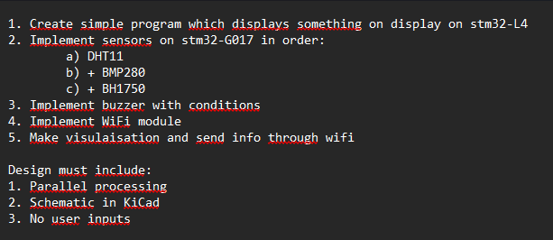
Assumptions (parameters)

Slide 4
A description of the components and subcomponents used
NUCLEO-G071RB – sensor based mcu
ESP8266 x2 (WiFi) – for communication via WiFi
NUCLEO-L476RG – display unit
Waveshare 4inch TFT Touch Shield – display
Temperature and humidity – DHT11
Light intensity x2 – BH1750
Pressure – BMP280
Wires, breadboard – for connections
Buzzer – alarm when humidity >= 60%

Slide 5
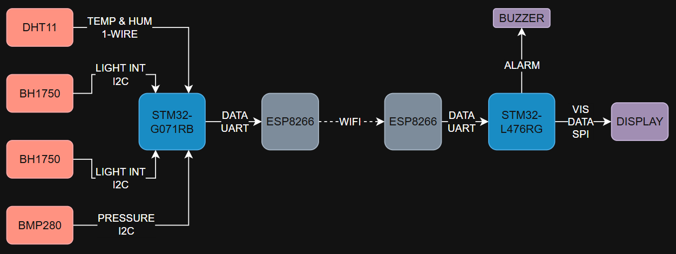
Data Flow Diagram

Slide 6
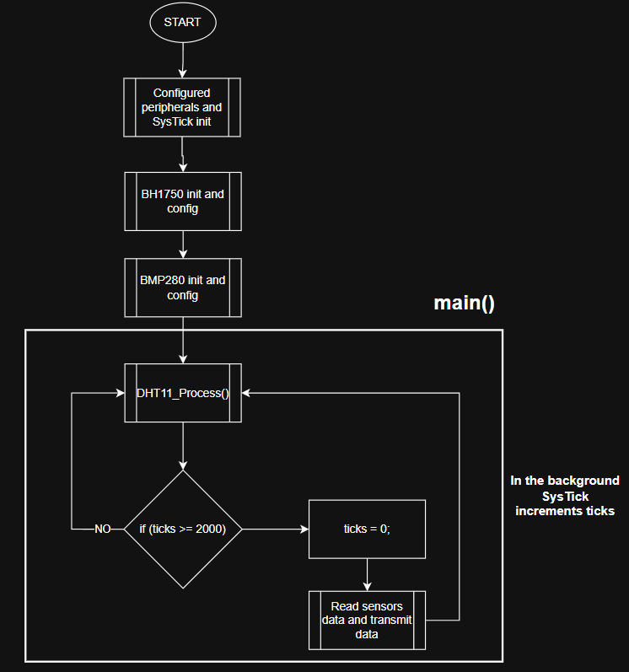
Flowchart – sensor base mcu (G071RB)

Slide 7
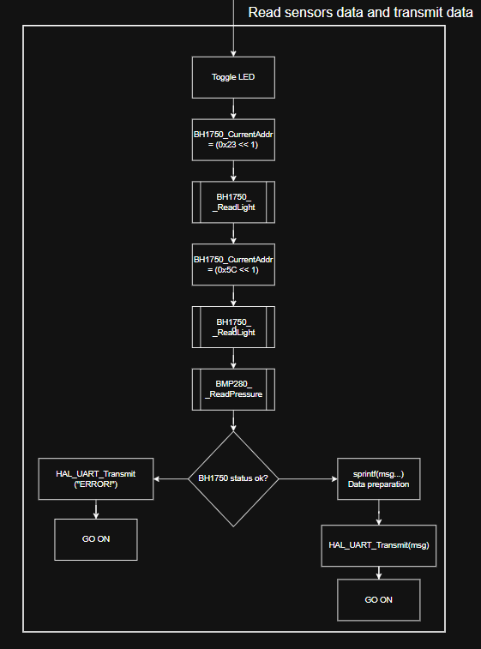
Flowchart – sensor base mcu (G071RB) – read sensors data and transmit data

Slide 8
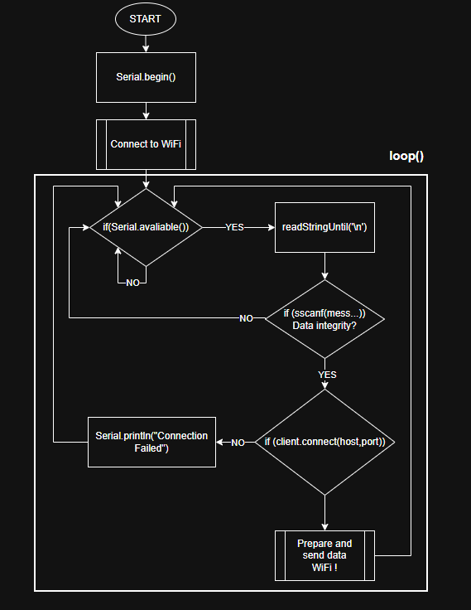
Flowchart – ESP8266 Tx

Slide 9
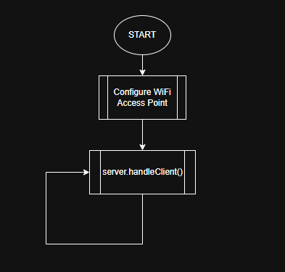
Flowchart – ESP8266 Rx

Slide 10
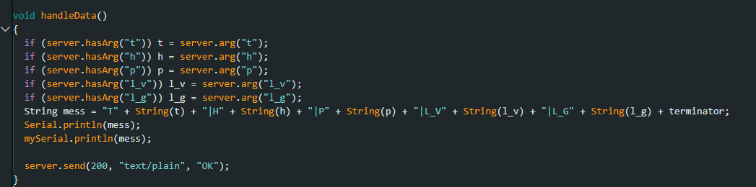
Flowchart – ESP8266 Rx – handleData

Slide 11
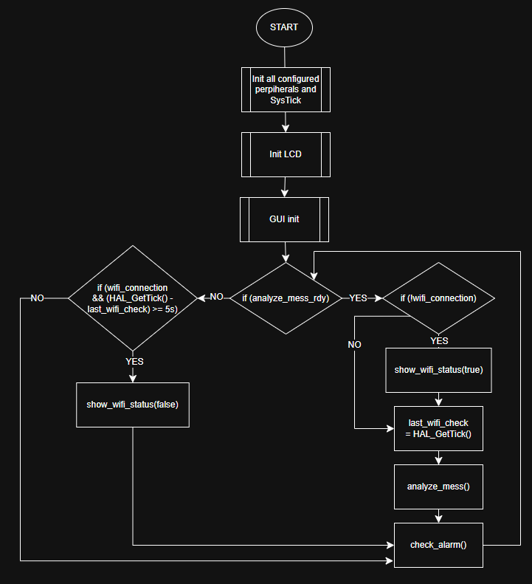
Flowchart – NUCLEO-L476RG

Slide 12
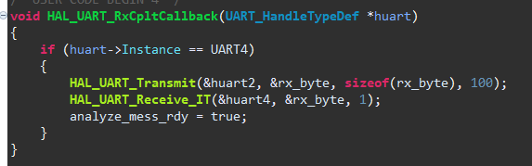
Flowchart – NUCLEO-L476RG UART

Slide 13
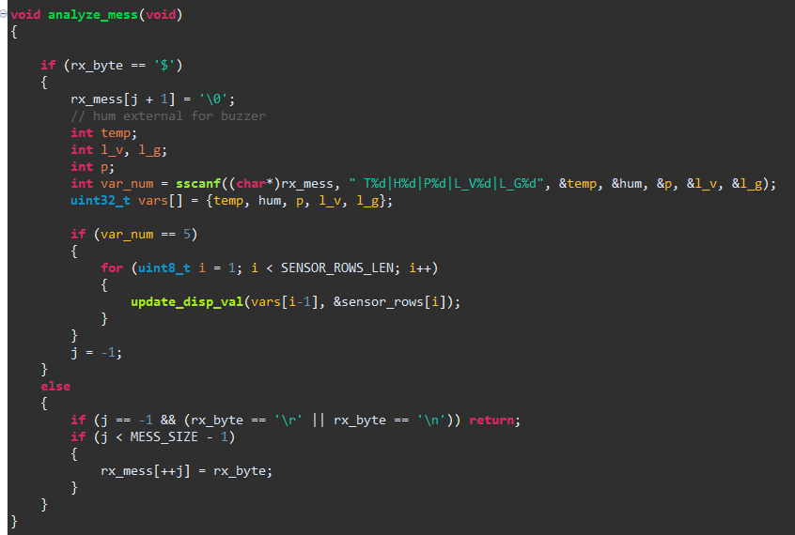
Flowchart – NUCLEO-L476RG analyze_mess()

Slide 14
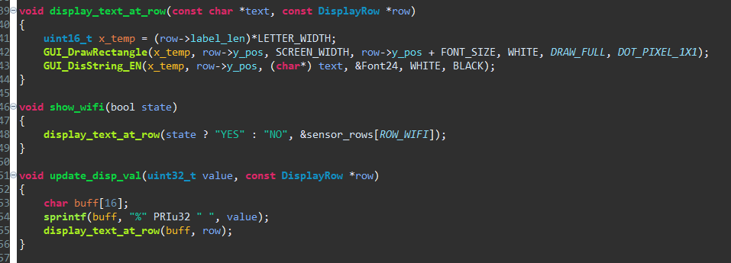
Flowchart – NUCLEO-L476RG gui funcs

Slide 15
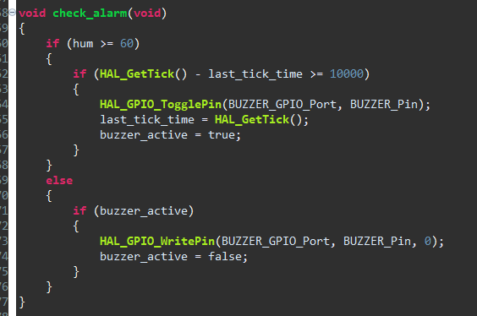
Flowchart – NUCLEO-L476RG alarm

Slide 16
uC peripherals used
UART – communication between stm and esp
I2C – comm. With sensors
USB – debbuging,
GPIO - for buzzer
Timers – for delays, debbuging
Systick - blink
SPI – display
Interrupts – waiting for UART message
WiFi – esp communication

Slide 17
A description of the final result of the project
What has been achieved:
1. A simple program was created to display data collected from sensors
2. Sensor readings were implemented on the NUCLEO-G071RB
3. A buzzer was implemented based on humidity levels
4. The WiFi module was implemented
5. The project was successfully completed
Issue detected: At random intervals, the temperature and humidity readings show zero. The cause of this issue has not been determined. The problem disappears after resetting the microcontroller

Slide 18
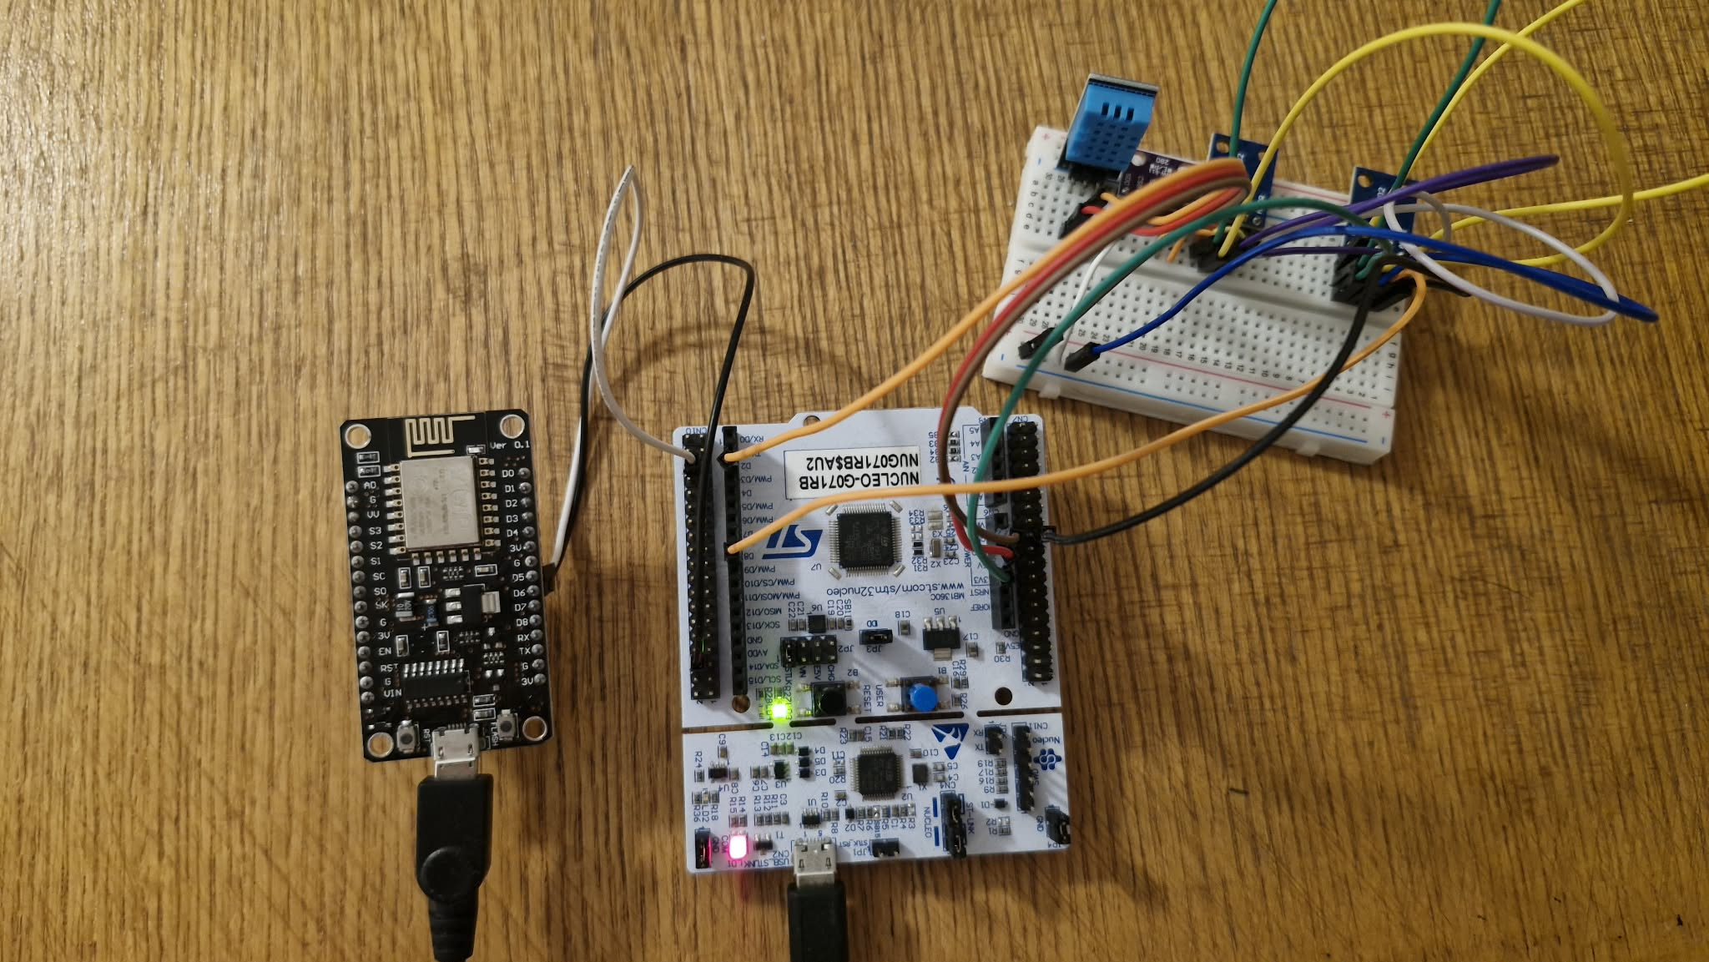
Sensor circuit

Slide 19
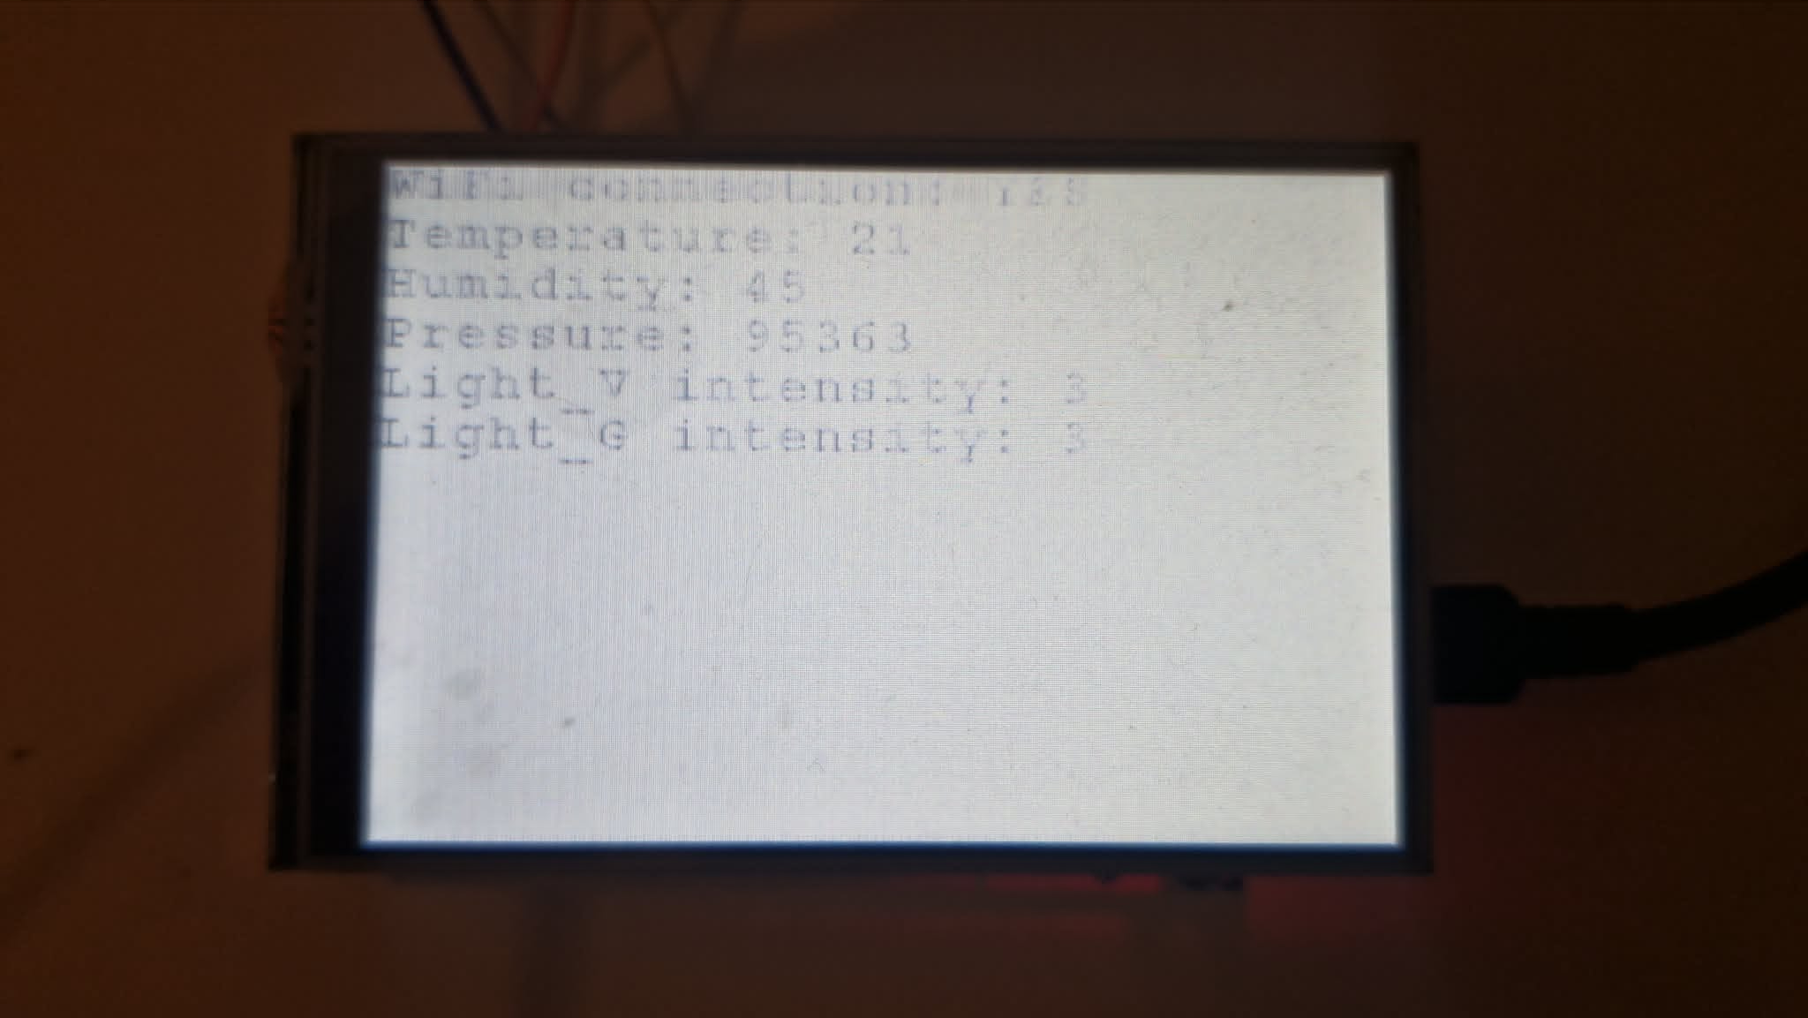
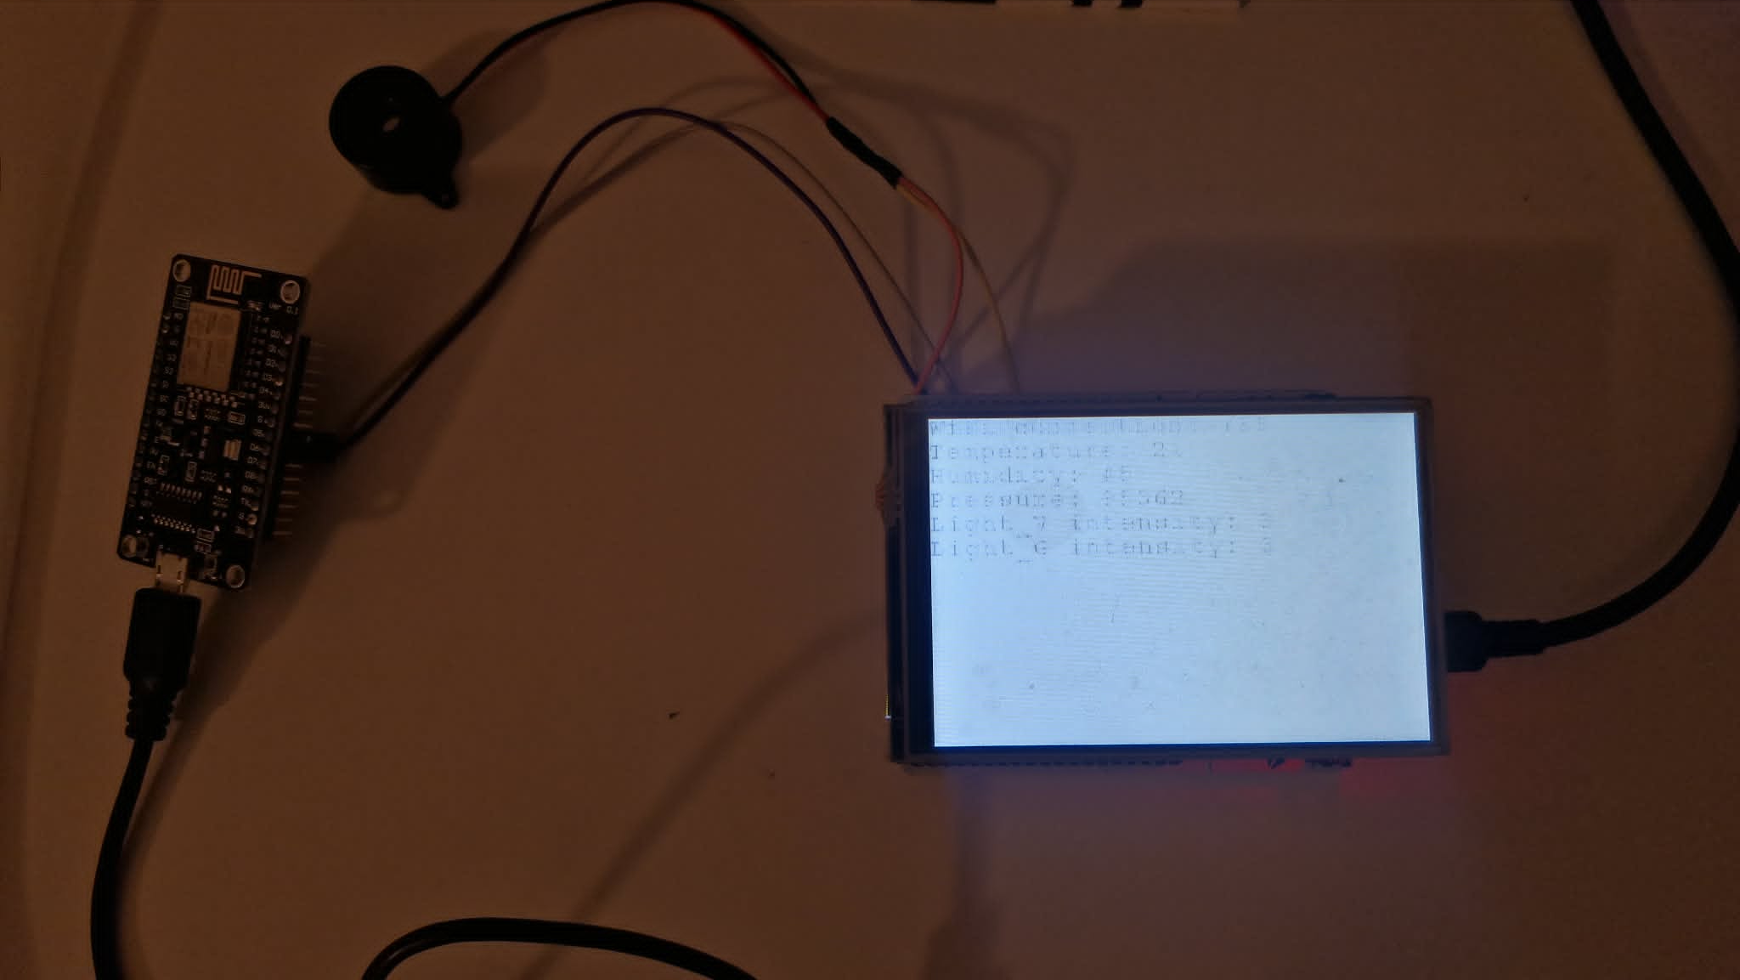
Display unit

Slide 20
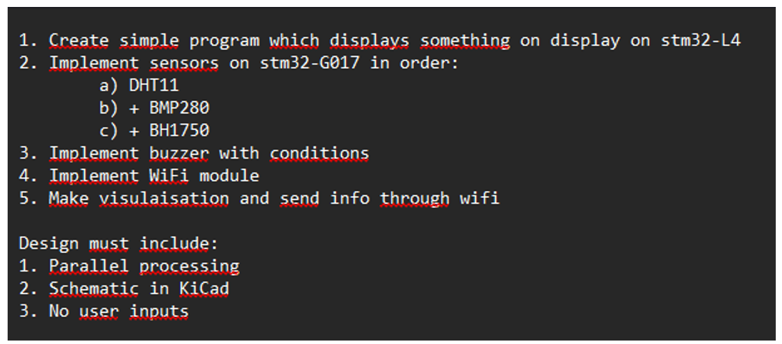




Comparison of the assumptions with the results obtained

Slide 21
https://github.com/Equerm8/stm_wifi_project
repo

